Slide 1
R Programming Course
1. Overview of R

Slide 2
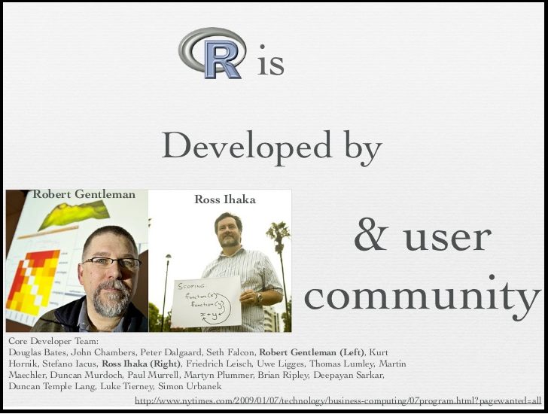
R Programming Course
1.1 What is R?
R is a language and environment for statistical computing and graphics.
R is case sensitive.
R is an "interpreted language", which means it executes statements (commands) one at a time.

Slide 3
R Programming Course
1.2 R and Statistics
There are about 25 packages supplied with R (called “standard” and “recommended” packages) and many more are available through the CRAN family of Internet sites (via http://CRAN.R-project.org) and elsewhere.
Most classical statistics and much of the latest methodology is available for use with R, but users may need to be prepared to do a little work to find it.

Slide 4
R Programming Course
1.3 R History
1991-93: Ross Dhaka and Robert Gentleman begin work on R project at U. Auckland
1995: R available by ftp under the GPL
1996-97: mailing list and R core group is formed
2000: John Chambers, designer of S joins the R core (wins a prize for best software from ACM for S)
2001-2005: Core team continues to improve base package
2009: Becoming the standard for statistics, although other languages are relevant (Python)
Many (>2000) other contributed “packages”

Slide 5
R Programming Course
1.4 Why R?
Graphics for data exploration and interpretation
Data manipulation including statistics as data
Statistical analysis
A. Standard univariate and multivariate generalizations of the linear model
B. Multivariate-structural extensions
Ease of programming for new applications

Slide 6
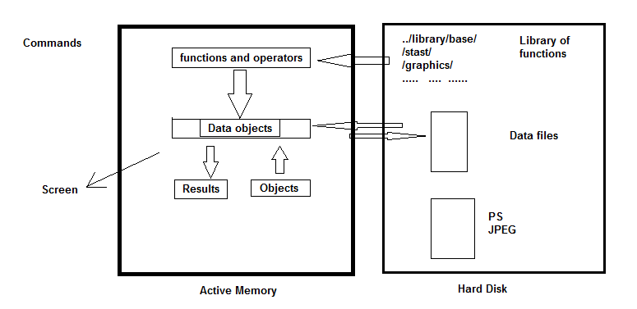
R Programming Course
1.5 How R works?
A schematic view of how R works

Slide 7
R Programming Course
1.5 How R works? - continued
All the actions of R done on objects stored in the active memory of the computer in the form of objects which have a name; no temporary files are stored.
The user executes the functions via commands.
The user can do actions on these objects with operators (arithmetic, logical, comparison,..) and functions (which are themselves objects).
The "base" package is the core of R and contains the basic functions of the language.
Each package has directory, there is a file containing all the functions of the package.

Slide 8
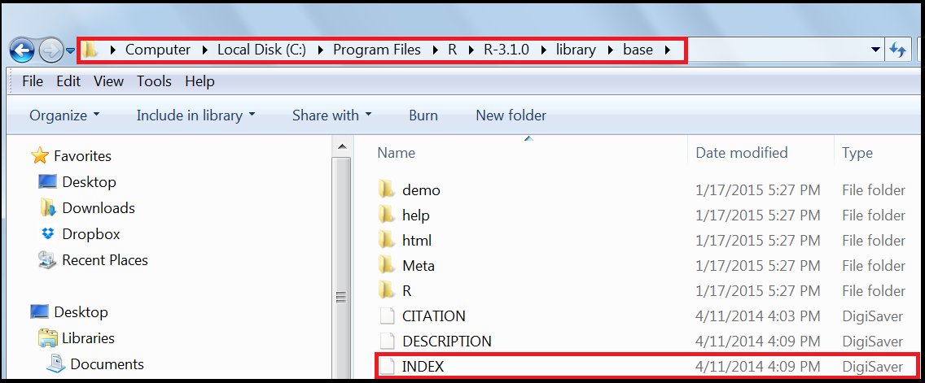
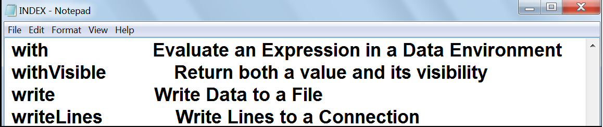
R Programming Course
1.5 How R works? - continued

Slide 9
R Programming Course
1.6 Where to get R and documentation ?
R can be downloaded from http://cran.r-project.org/
An Introduction to R by Longhow Lam (PDF, 2010-10-28, 212 pages).
R and Data Mining: Examples and Case Studies by Yanchang Zhao (PDF, 2013-04-26, 160 pages).
R for Beginners by Emmanuel Paradis (PDF).
Kickstarting R (version 1.6) compiled by Jim Lemon, a short introduction in English as HTML files: download as gzipped TAR or ZIP; or browse directly.

Slide 10

R Programming Course

Slide 11
R Programming Course
R program uses a compiler to run its programs. This statement is
Always True
Always False
May or may not be true
I do not know the answer
User executes the functions via commands. This statement is
Always True
Always False
May or may not be true
I do not know the answer

Slide 12
R Programming Course
R stores the results of statistical analysis in a fit object for subsequent interrogation by further R functions.
Always True
Always False
May or may not be true
I do not know the answer
When R is running, variables, data, functions, results, etc. are stored in the ___________ of the computer in the form of objects which have a name.
Active memory
Hard disk
All of the above
None of the above

Slide 13
R Programming Course
R program uses a compiler to run its programs. This statement is
b) Always False
User executes the functions via commands. This statement is
Always True
R stores the results of statistical analysis in a fit object for subsequent interrogation by further R functions.
Always True
When R is running, variables, data, functions, results, etc. are stored in the ___________ of the computer in the form of objects which have a name.
Active memory

Slide 14
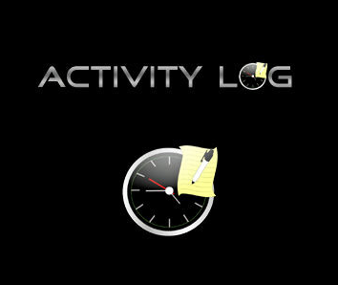
R Programming Course

Slide 15

R Programming Course
Activity 1: File INDEX in the package "base" contains all the functions of the base package. List its contents!
.R_HOME/library/base
Step 1: Click on the R icon
Steps 2 - 6: Type the commands as below at > prompt:
main_dir <- Sys.getenv("R_HOME")
sub_dir <- “library/base”
setwd(file.path(main_dir,sub_dir))
getwd()
file.show(“INDEX”)
Note:
1. The function Sys.unsetenv removes environment variables
2. The function setwd() is used to set the working directory
3. The function getwd() is used to get the working directory
4. The function file.show() is used to display the file contents

Slide 16
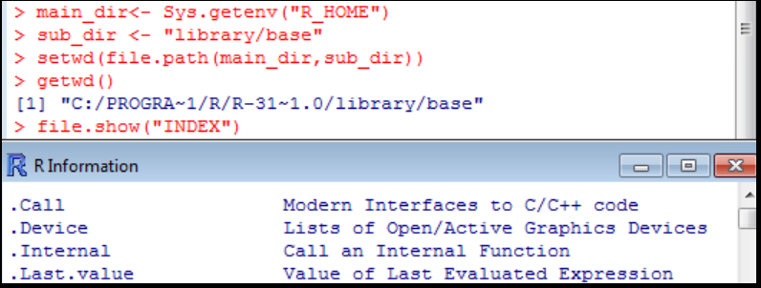
R Programming Course

